Slide 1
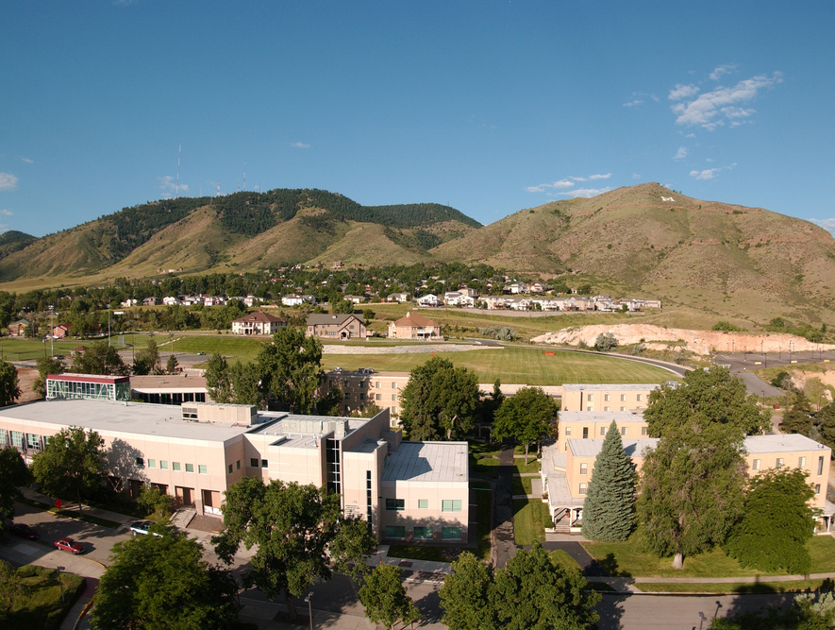
Colorado School of Mines
Computer Vision
Professor William Hoff
Dept of Computer Science
http://inside.mines.edu/~whoff/

Slide 2
Edge Detection

Slide 3
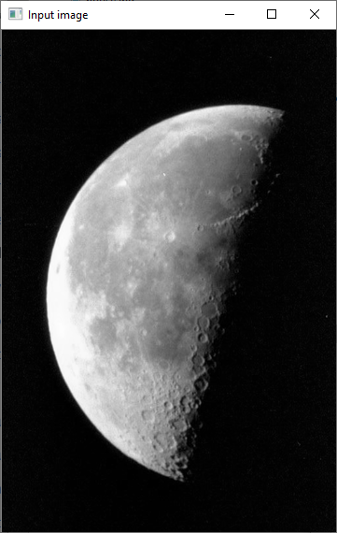
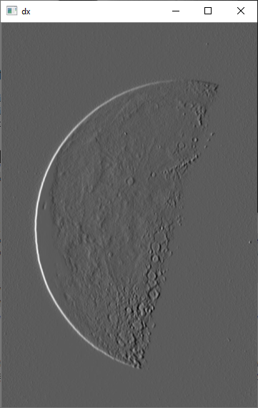
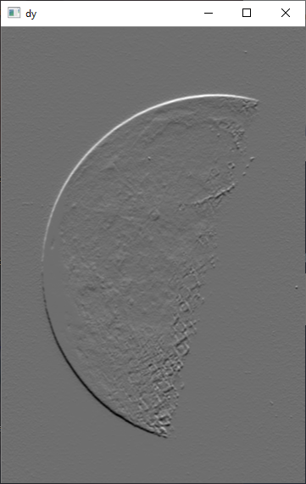
Sobel edge operators
-1
0
+1
-1
-2
-1
-2
0
+2
0
0
0
-1
0
+1
+1
+2
+1

Slide 4
Image Gradient
Compute gradient components using first derivative operators
Gradient magnitude shows location of edges in the image
Gradient angle shows direction of edge

Slide 5
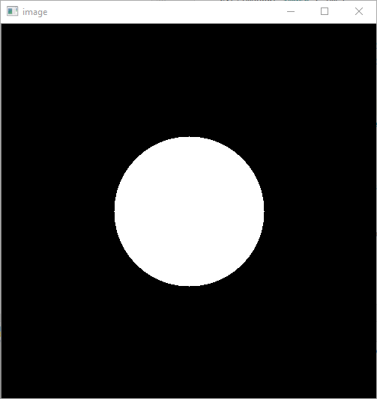
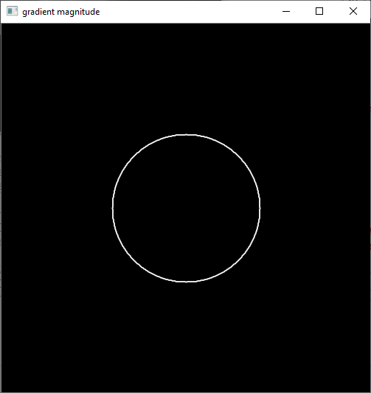
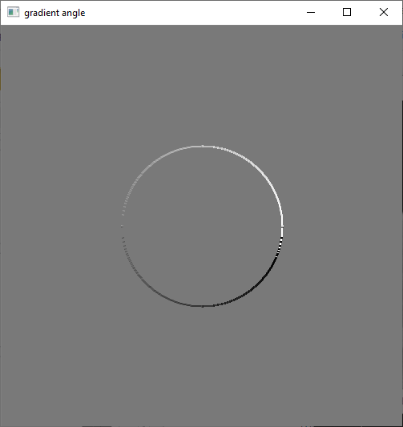
Gradient example
# Scale values to 0..255 (for display purposes).
def scale_values(img):
return cv2.normalize( # Scale so we can see values
src=img, dst=None, alpha=0, beta=255,
norm_type=cv2.NORM_MINMAX, dtype=cv2.CV_8U)
# Create simple image of a circle.
img = np.zeros((500,500), dtype=np.uint8)
cv2.circle(img, (250,250), 100, 255, -1)
cv2.imshow("image", img)
# Compute gradient components using 1st derivative operators.
Dx = cv2.Sobel(img, ddepth=cv2.CV_32F, dx=1, dy=0, ksize=3)
Dy = cv2.Sobel(img, ddepth=cv2.CV_32F, dx=0, dy=1, ksize=3)
# Compute gradient magnitude.
grad_mag = (Dx ** 2 + Dy ** 2) ** 0.5
cv2.imshow("gradient magnitude", scale_values(grad_mag))
# Compute gradient angle.
grad_ang = np.arctan2(Dy, Dx)
cv2.imshow("gradient angle", scale_values(grad_ang))

Slide 6
Gradient magnitude – real image
Original image “pout.tif”
Gradient magnitude, using Sobel masks
Lots of pixels with high gradients! Not useful …

Slide 7
What we want
We want to identify “edge points”: points along the boundary of an object
Then we can use that to look for shapes, etc
The output should be a binary image, where 1=edge point exists, 0=no edge point
We could threshold the gradient image to get the binary image …

Slide 8
Threshold Edge Operator Results
We can threshold edge magnitudes, to produce a binary image
Problem – only want one response to an edge
Low threshold
High threshold

Slide 9
Better: Non-maxima suppression
To get a one-pixel wide edge, use the point that is the local maximum in the direction of the gradient
Direction of gradient
90
100
90
80
70
80
90
100
90
80
70
80
90
100
90
80
70
70
80
90
100
90
80
70
80
90
100
90
These points are local maxima in the direction of the gradient
Non-maxima suppression

Slide 10
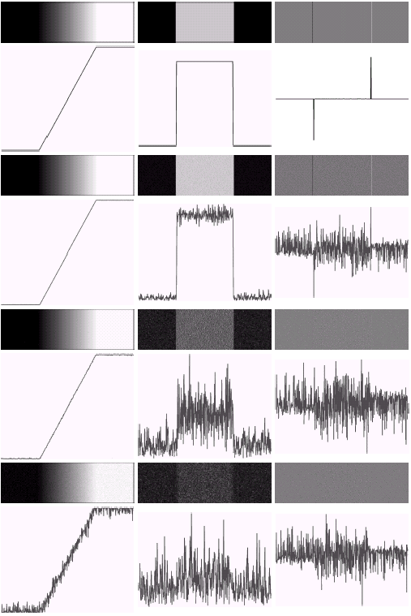
Problem: derivatives amplify noise
First and second derivatives of noisy ramp edge
Even a small amount of noise greatly affects the output
Need to smooth the image before taking derivatives

Slide 11
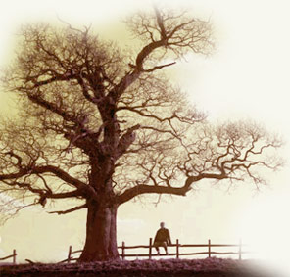
Solution: blur the image
Do Gaussian blurring before edge detection
This will reduce noise
But what is noise, and what is just some small detail?

Slide 12
Scale-Space
Noise vs detail: It depends what we are interested in
Objects occur at different scales in an image – we need operators of different sizes to detect them
Scale space: The space of images created by applying a series of operators of different scales
Convolving with a Gaussian blurs the image, wiping out all structure much smaller than σ
Increasing σ

Slide 13
Standard edge detection
Steps
Smooth the image with a Gaussian
Find digital derivatives and compute the gradient magnitude and direction
Find points with magnitude that exceed a threshold, and are local maxima in the direction of the gradient
The “Canny” edge detector does this
It has been show to give
Good detection (low probability of detecting false edges and missing real edges)
Good localization (detected edges must be close to the true edges)
Single response (return only one point for each true edge point)

Slide 14
Additional step: Edge Linking
We want to join edge points into connected curves or lines
Problem:
Some edge points along the curve may be weak, causing us to miss them
This would result in a broken curve
Solution:
We use a high threshold to make sure we capture true edge points
Given these detected points, link additional edge points into contours using a lower threshold (“hysteresis”)
Algorithm
Find all edge points greater than t_{high}
From each strong edge point, follow the chains of connected edge points in both directions perpendicular to the edge normal
Mark all points greater than t_{low}

Slide 15
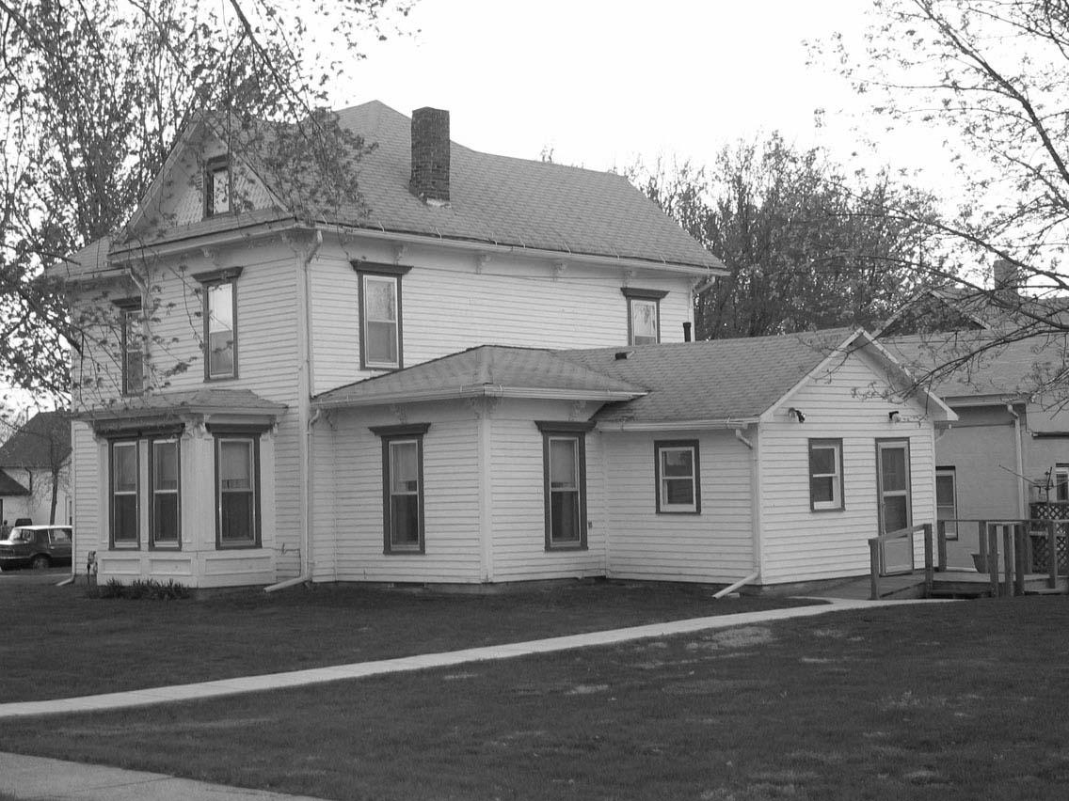
OpenCV
edge_img = cv2.Canny(img, low_thresh, high_thresh, L2gradient=True)
import cv2 def main(): gray_img = cv2.imread("house.jpg", cv2.IMREAD_GRAYSCALE) # Smooth the image with a Gaussian filter. If sigma is not provided, it # computes it automatically using # sigma = 0.3*((ksize-1)*0.5 - 1) + 0.8 sigma = 1.0 gray_img = cv2.GaussianBlur( src=gray_img, ksize=(0, 0), # kernel size (should be odd numbers; if 0, compute it from sigma) sigmaX=sigma, sigmaY=sigma) # Vary the threshold, but use same threshold for low and high. for t in range(30, 150, 20): low_thresh =t high_thresh = t print("low_thresh = %d, high_thresh = %d" % (low_thresh, high_thresh)) edge_img = cv2.Canny(gray_img, low_thresh, high_thresh, L2gradient=True) cv2.imshow("Edge image", edge_img) cv2.waitKey(0) # Show the benefit of hysteresis; i.e., two thresholds. for t in range(30, 150, 20): low_thresh = t high_thresh = 2.5*t print("low_thresh = %f, high_thresh = %f" % (low_thresh, high_thresh)) edge_img = cv2.Canny(gray_img, low_thresh, high_thresh, L2gradient=True) cv2.imshow("Edge image", edge_img) cv2.waitKey(0) if __name__ == "__main__": main()
Image “house.jpg”

Slide 16
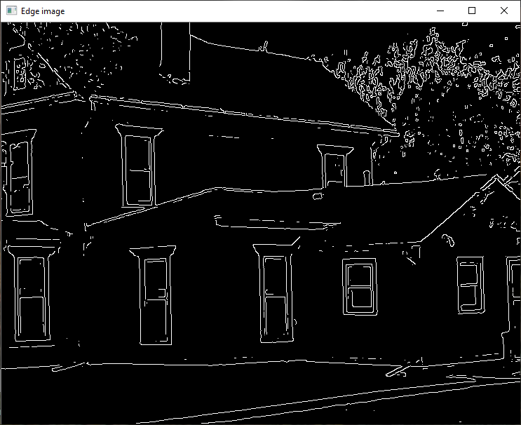
Edge detection, no linking (hysteresis)

Slide 17
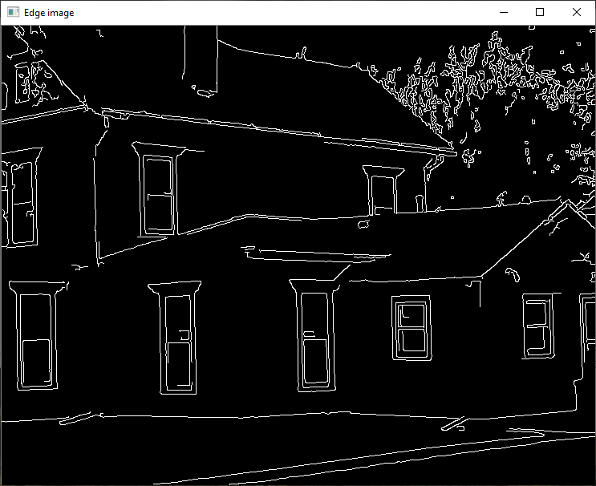
Edge detection, with linking (hysteresis)

